Slide 2
Osmordred & more
Dr. Guillaume Godin
Principal ML Engineer / AI director
Osmo
North American RDKit UGM
April 10-11 2025

Slide 3
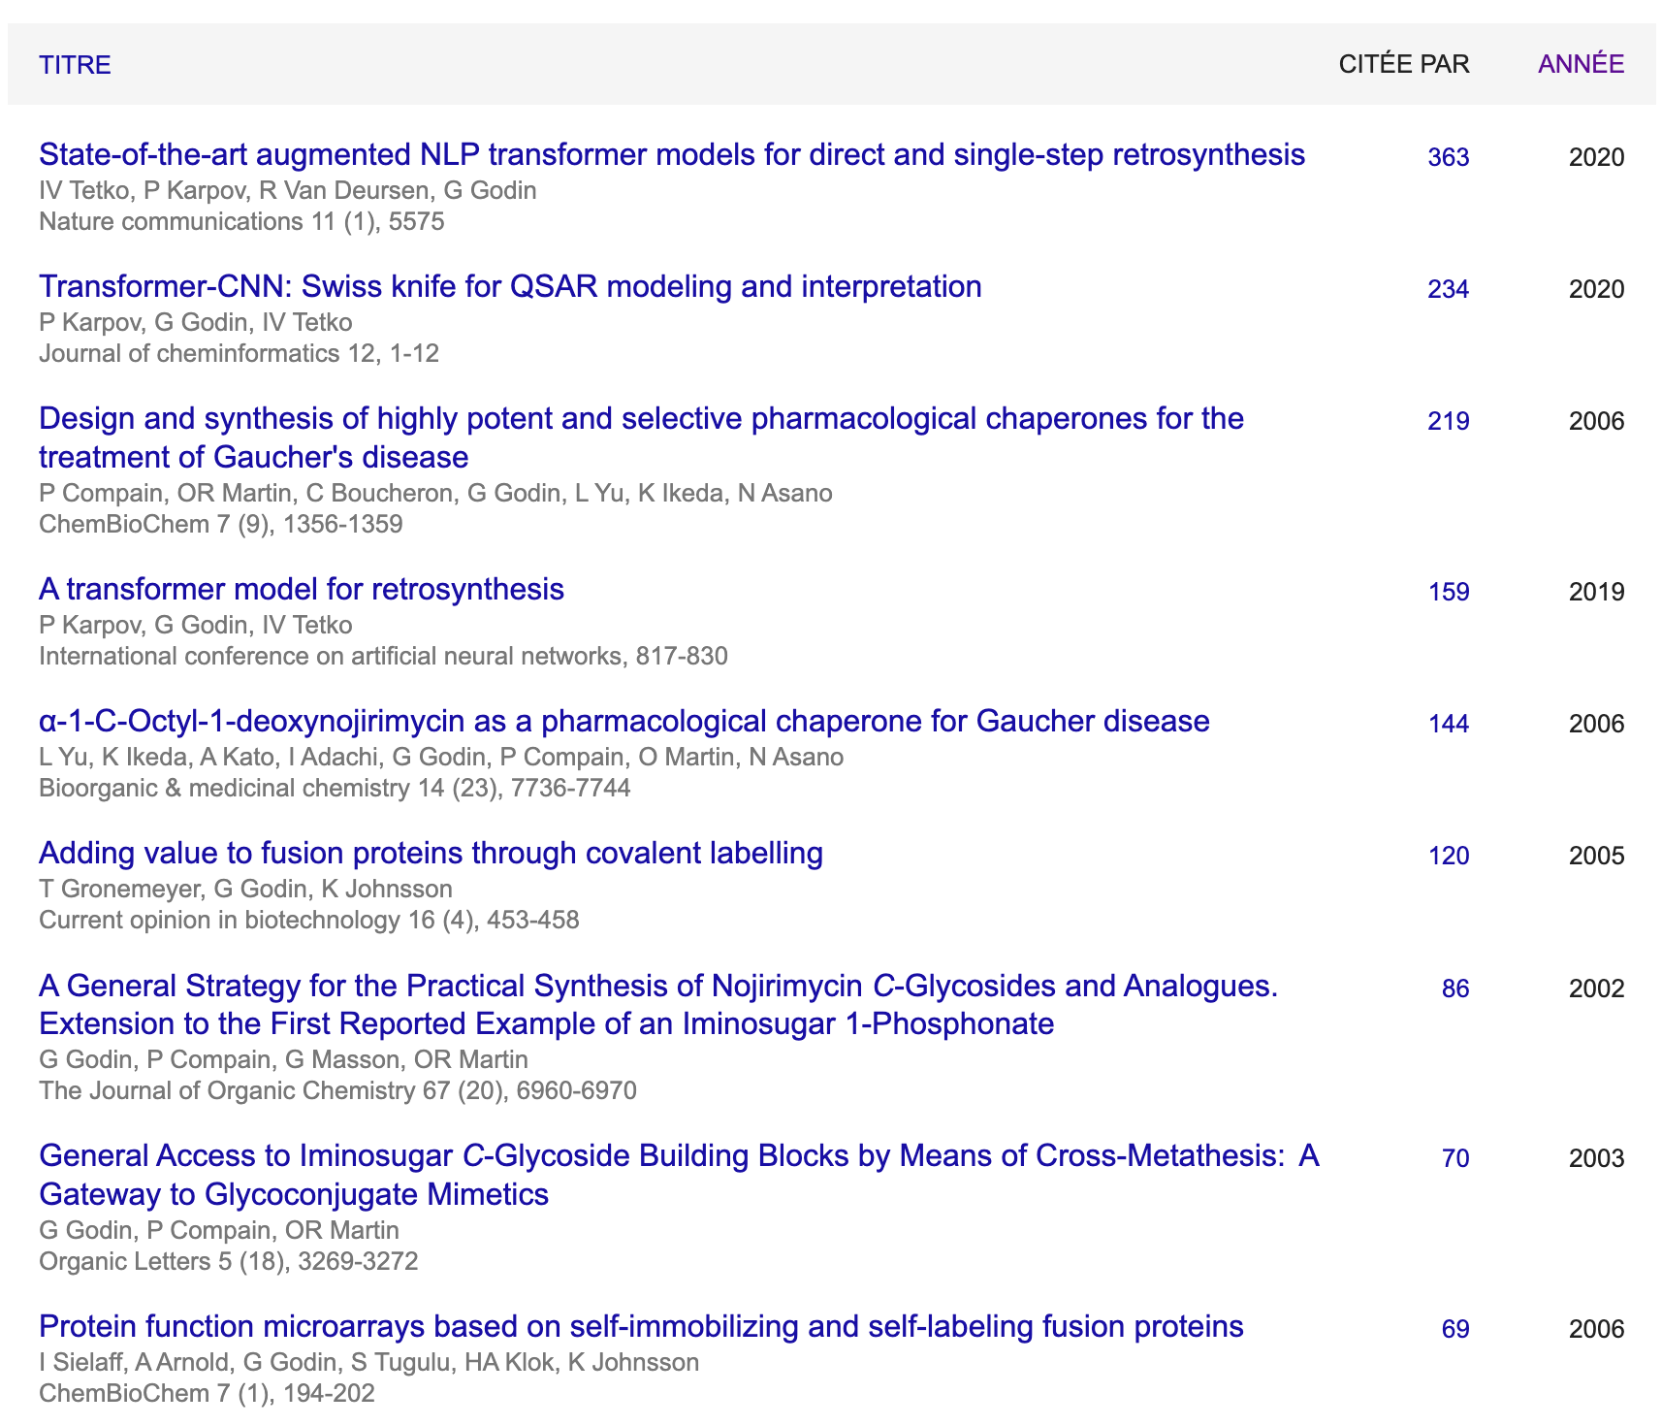
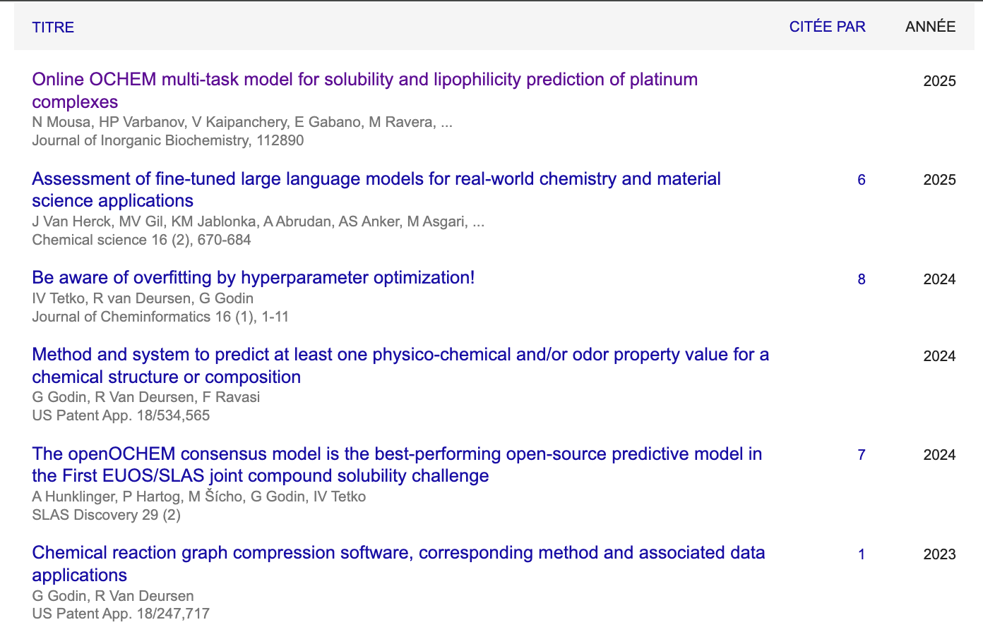
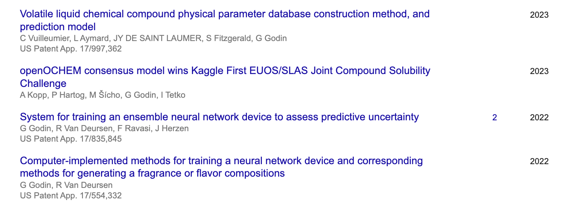

Patent
Patent
Patent
Patent
Patent

Slide 4
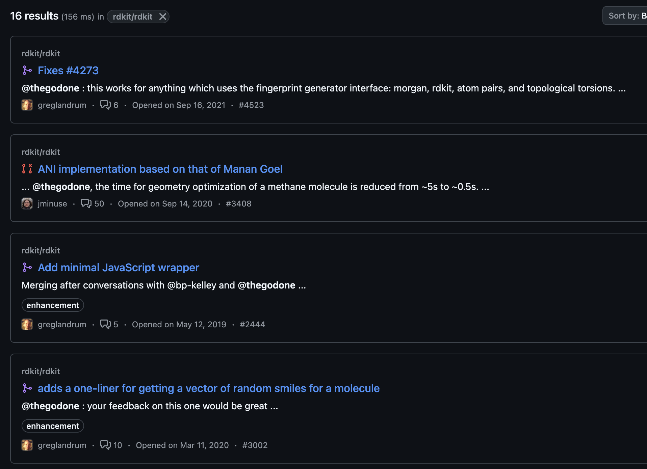
Rdkit is my Swiss knife

Slide 5
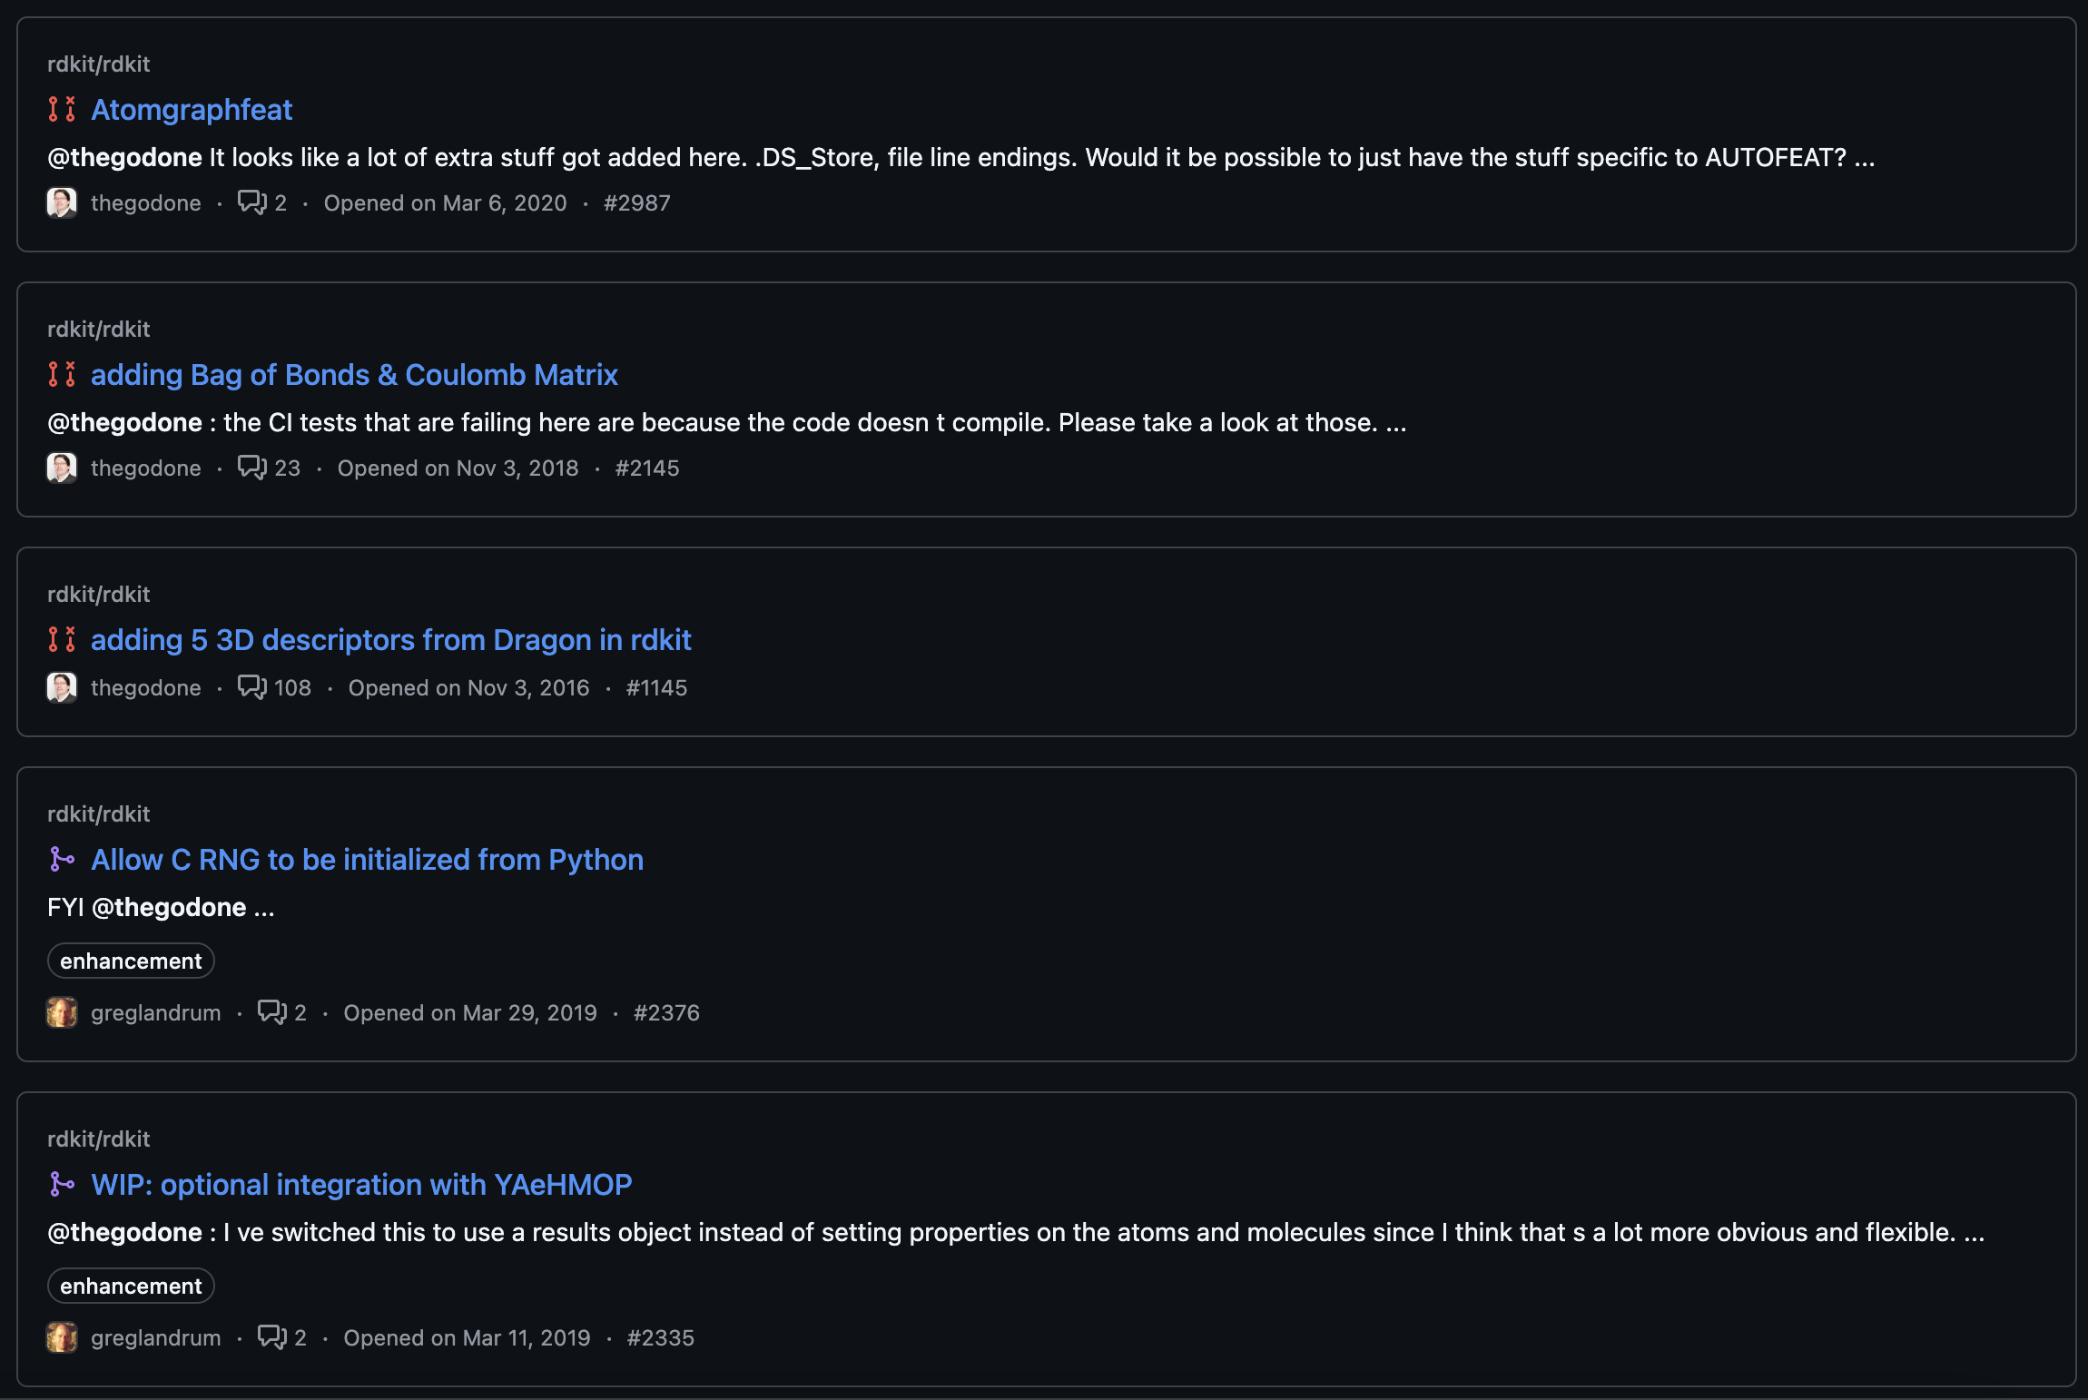

Slide 6
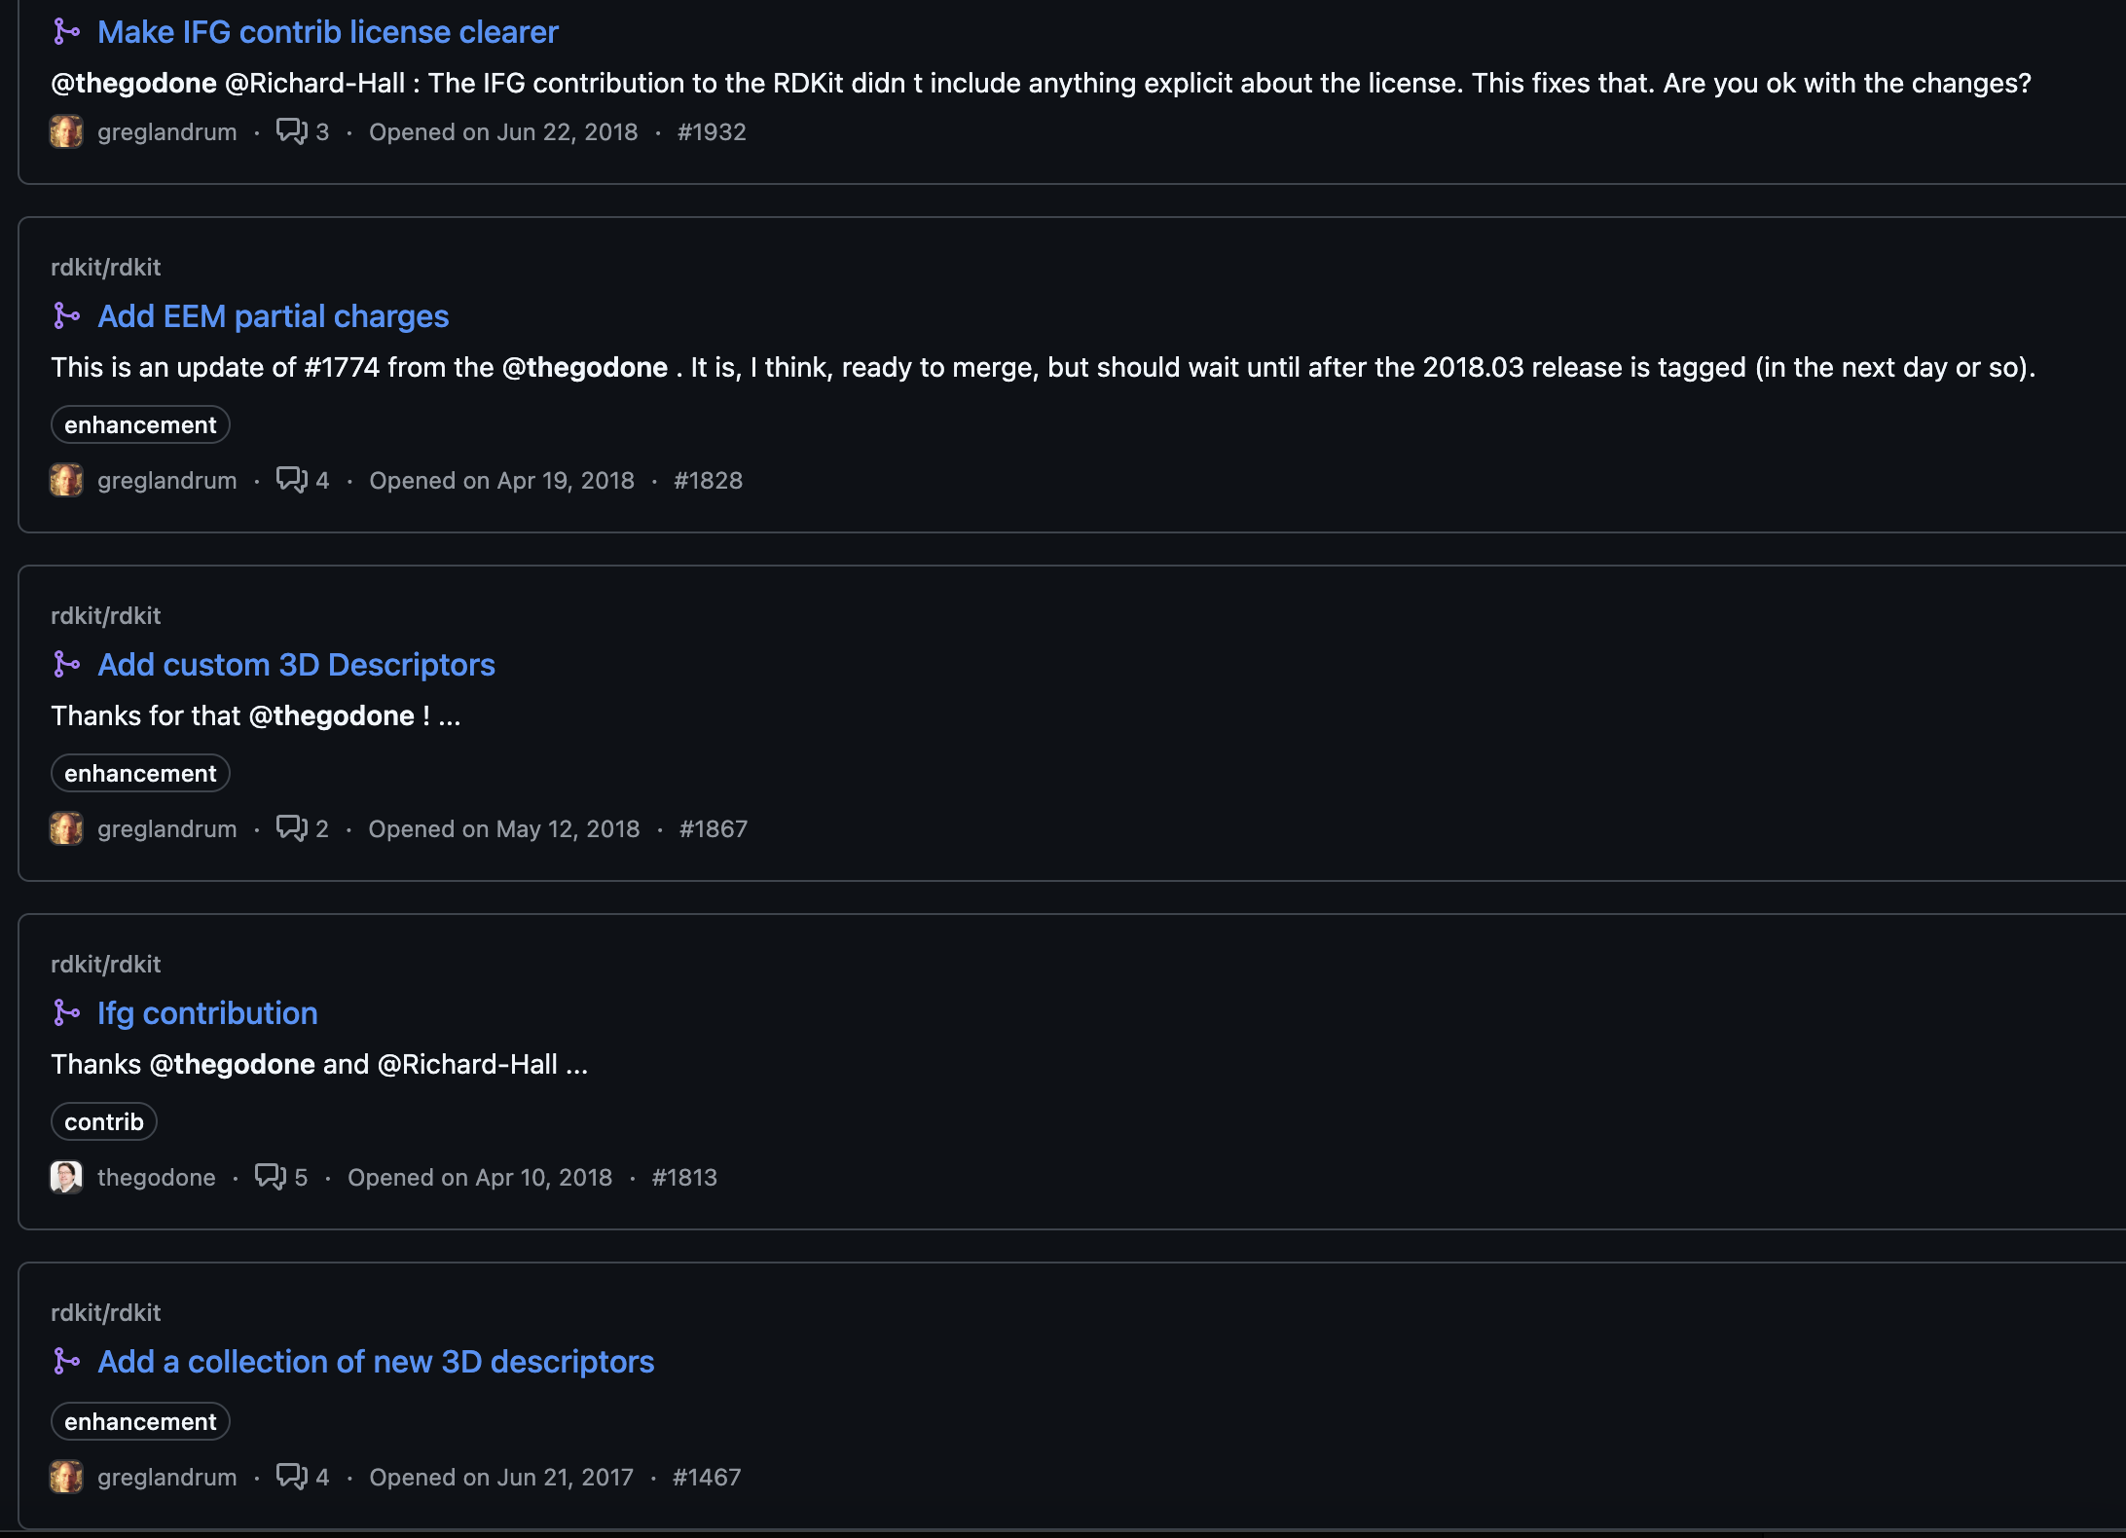

Slide 7
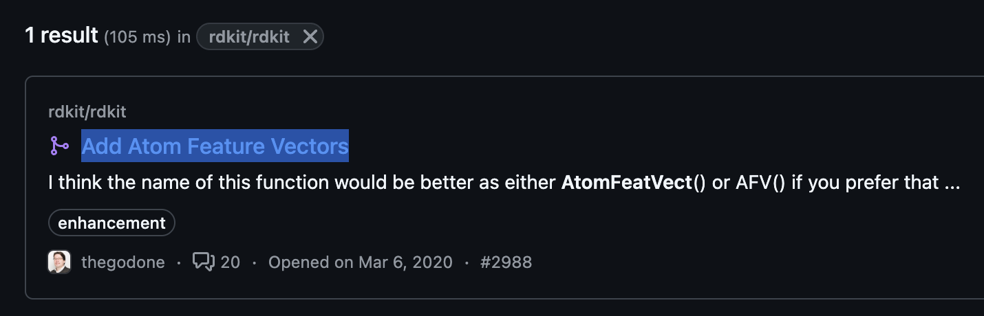
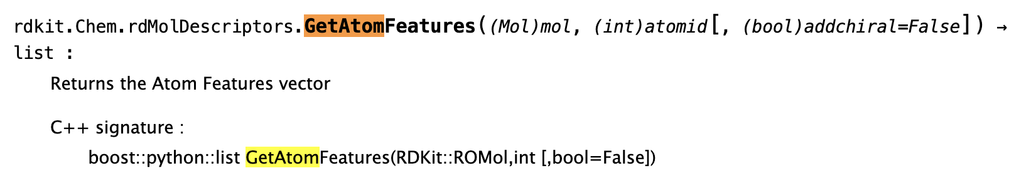
Fast atom graph neural network features

Slide 8
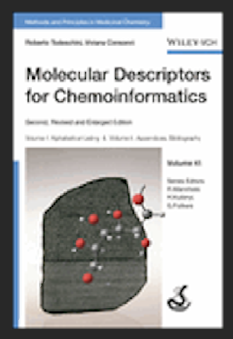
Mordred and co
2018 > Mordred - Moriwaki, H., Tian, YS., Kawashita, N. et al. J Cheminform. 2018, 10(1):1-4
2013 > ChemoPy - Cao D. S., Xu Q. S., Hu Q. N., et al. Bioinformatics, 2013, 29(8):1092-1094.
2010 > Padel - Yap C. W. J Comp. Chem. 2011, 32(7):1466-74.
2006 > Dragon - Mauri, A., Consonni, V., Pavan, M. & Todeschini R. Match Com. Math. Comput. Chem. 2006, 56:237-248
…
2009: Molecular Descriptors for Chemoinformatics
Todeschini R. & Consonni, V. Wiley
https://rdkit.blogspot.com/2019/11/introducing-new-rdkit-javascript.html

Slide 9
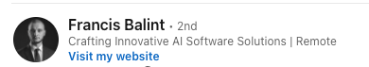
is there a best language ?
Each language has its strengths, depending on your needs.
Python: great for quick development with strong library support
Go : high performance and excellent concurrency handling
Javascript : best for event-driven, non-blocking applications
Rust : ideal for memory safety and speed
Java : the go-to choice for enterprise-grade systems
https://www.linkedin.com/posts/fbatilla_microservice-python-go-activity-7313281728226168833-mLN3?
utm_source=share&utm_medium=member_desktop&rcm=ACoAAAH1kD4BFaWT58opBmHeGFvi1h2mBVoVvAc
https://pez.github.io/languages-visualizations/v2025.01.21/#loops

Slide 10

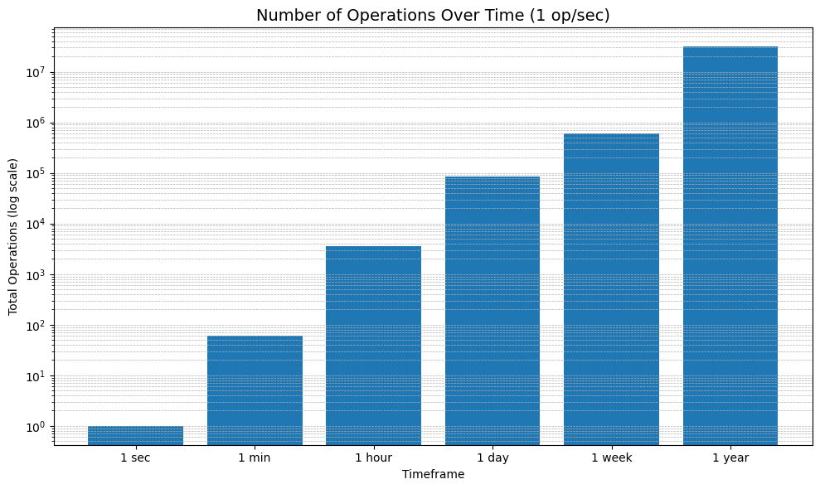
Speed vs big data
We can make ~31 Millions of operations per second in 1 year.
This is incompatible with big data without huge parallelization.
You must have a very fast inference model to apply on big data

Slide 11
2D properties are:
Padel/Mordred likes
ABCIndex
AcidBase
AdjacencyMatrix
Aromatic
AtomCount
Autocorrelation
BCUT
BalabanJ
BaryszMatrix
BertzCT
BondCount
RNCGRPCG
CarbonTypes
Chi
Constitutional
DetourMatrix
DistanceMatrix
EState
EccentricConnectivityIndex
ExtendedTopochemicalAtom
FragmentComplexity
Framework
HydrogenBond
InformationContent*
KappaShapeIndex
Lipinski
LogS
McGowanVolume
MoeType
MolecularDistanceEdge
MolecularId
PathCount
Polarizability
RingCount
RotatableBond
SLogP
TopoPSA
TopologicalCharge
TopologicalIndex
VdwVolumeABC
VertexAdjacencyInformation
WalkCount
Weight
WienerIndex
ZagrebIndex

Slide 12
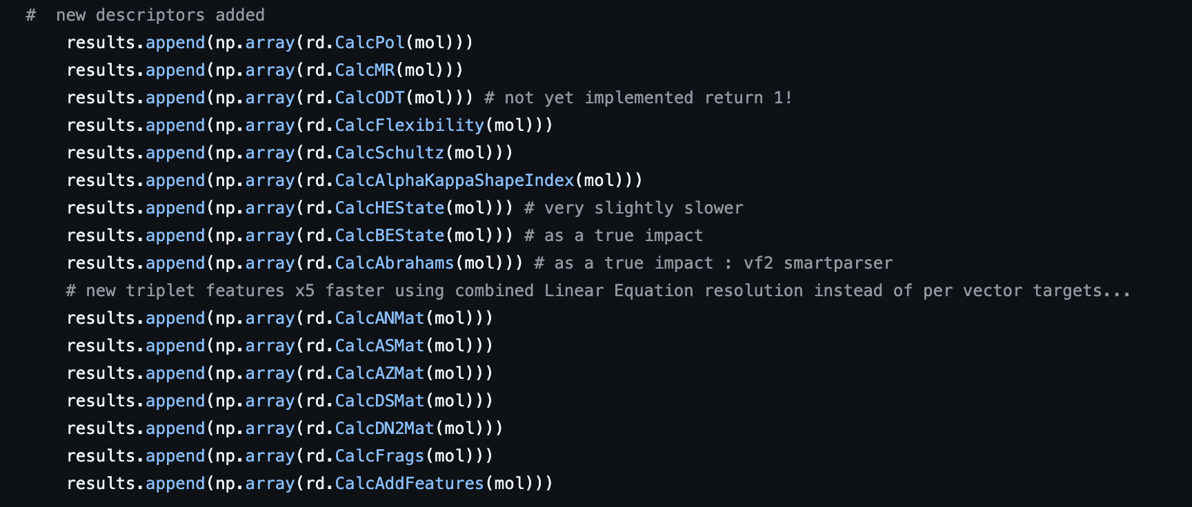
New features available
Pol
MR
Flexibility
Schultz
AlphaKappaShapeIndex
HEState
BEState
Abrahams
Triplet indexes
Frags (ie SMARTS)
AddFeatures (mine)
Additional ones (or ported)
Total 2D properties: 3585
H and B EState are “Hydrogens” and “Bond”

Slide 13
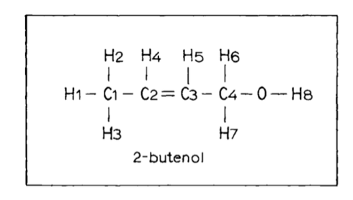
InformationContents reproducibility and speed
“The determination of equivalent vertices and associated information content of a graph depends on the criterion of equivalency… Therefore, the information content of a graph is not unique.”
“… and the depend of the chemical toolkit (like aromaticity)”
Goal Cluster each atom based on the pseudo graph key at a given radius
Brut force: build each atom key at a given radius and cluster those key, repeat for each radius (generate full key radius without memory)
Mordred : build and store in memory each atom key radius and iterate to next radius (radius key growth)
Basak & co (1984):
1. if an atom is in a single cluster stop to investigate this atom it already alone.
2. Only compare atoms in a previous cluster during the growth.
Basak method is regressive so we can improve knowing that:
No need to store key
No need to compare all keys
3. Just look at unvisited next atoms from current radius!
Explicit Hydrogens
NEIGHBORHOOD COMPLEXITIES AND SYMMETRY OF CHEMICAL GRAPHS AND THEIR BIOLOGICAL APPLICATIONS, A. B. Roy, S. C. Basak, D. K. Harriss, and V. R. Magnuson 1984

Slide 14
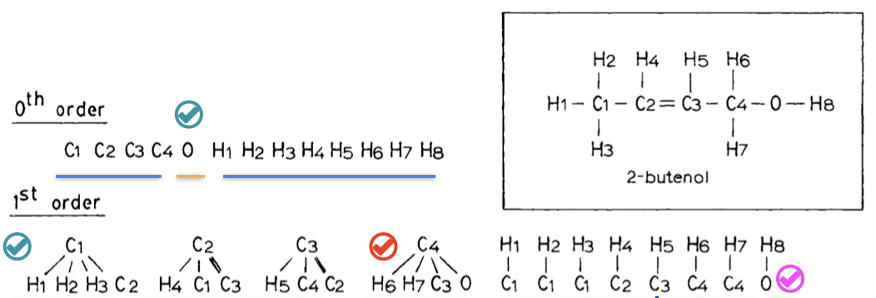
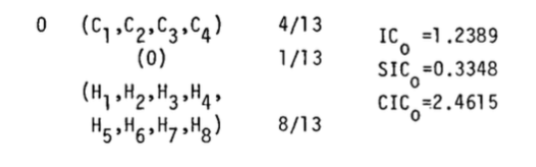
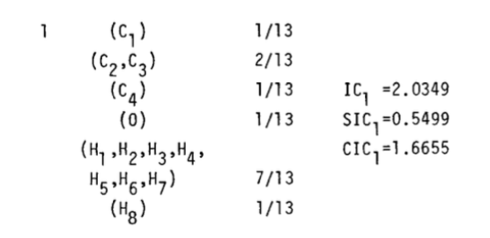
InformationContents reproducibility and speed
Goal Cluster each atom based on the graph depth
“The determination of equivalent vertices and associated information content of a graph depends on the criterion of equivalency… Therefore, the information content of a graph is not unique.”
“… and the depend of the chemical toolkit (like aromaticity)”
3 clusters
6 clusters
3 clusters, 12 atoms
2 clusters, 9 atoms
NEIGHBORHOOD COMPLEXITIES AND SYMMETRY OF CHEMICAL GRAPHS AND THEIR BIOLOGICAL APPLICATIONS, A. B. Roy, S. C. Basak, D. K. Harriss, and V. R. Magnuson 1984

Slide 15
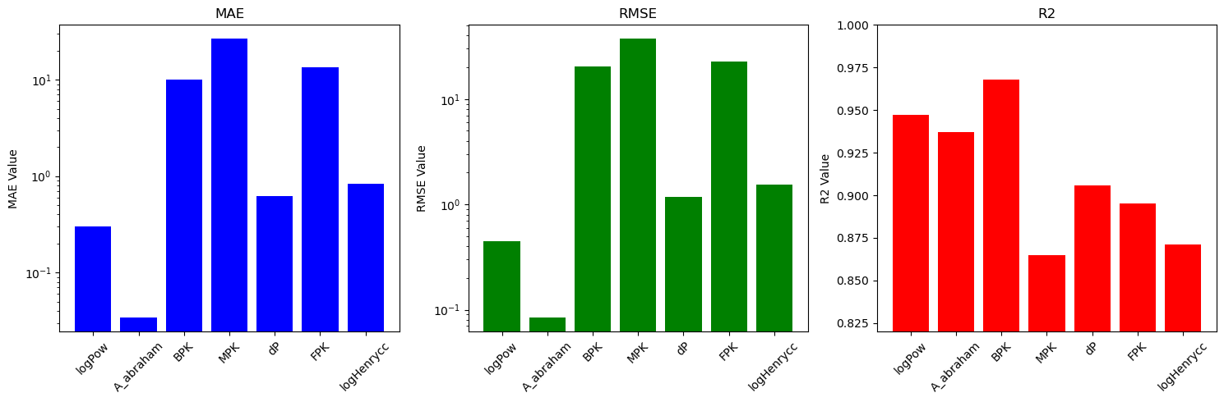
Xgboost Osmordred example
Multiple regression task* : Density, refractive index, logPow, Abrahams, Boiling Point, Melting Point, Hansens, Flash Point, Vapor pressure, Volatility, Henry Constant
Features
Xgboost
Chain of Models (ie 18 models)
Osmordred
Density
Xgboost
Osmordred+X_D
RI
Xgboost
Osmordred+X_D+X_RI
logPow
Xgboost
Osmordred+X_D+…+X_H
logS
* 22’060 molecules sparse dataset

Slide 16
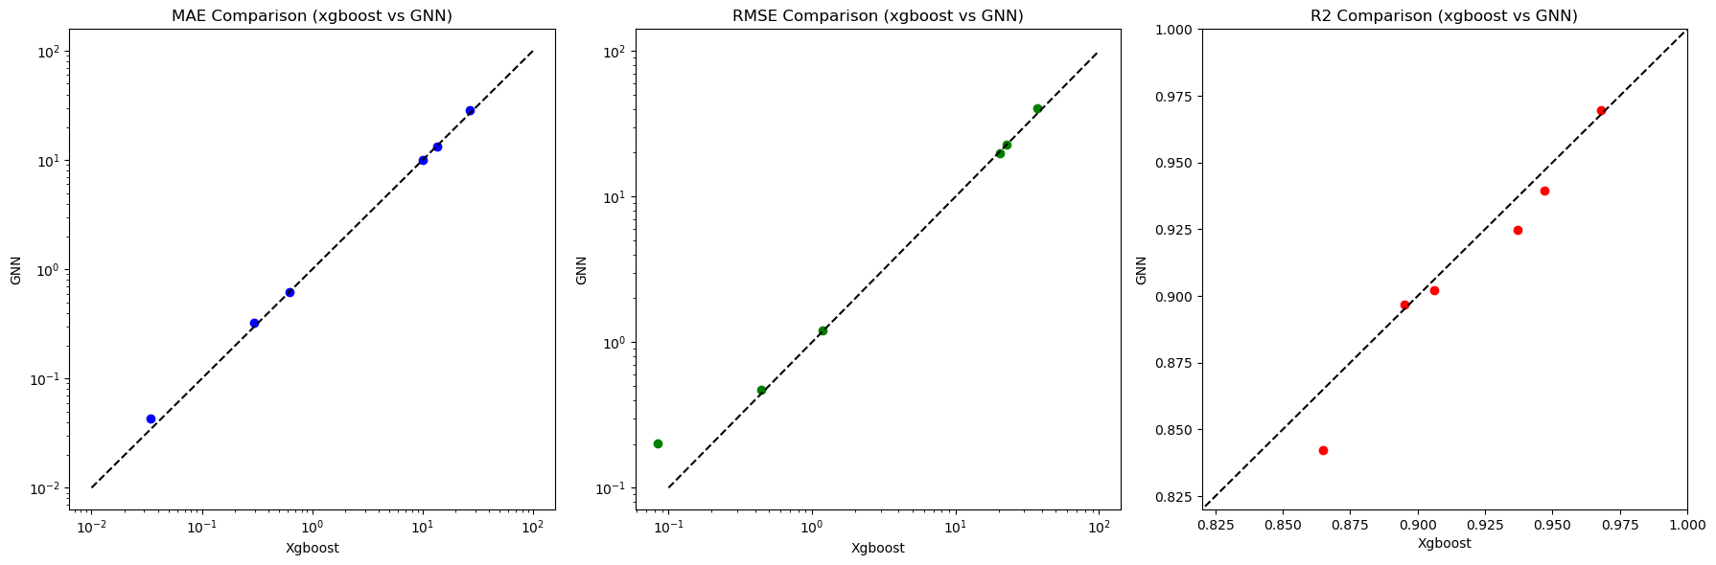
GNN ~ Xgboost with Osmordred
* 22’060 molecules sparse dataset

Slide 17
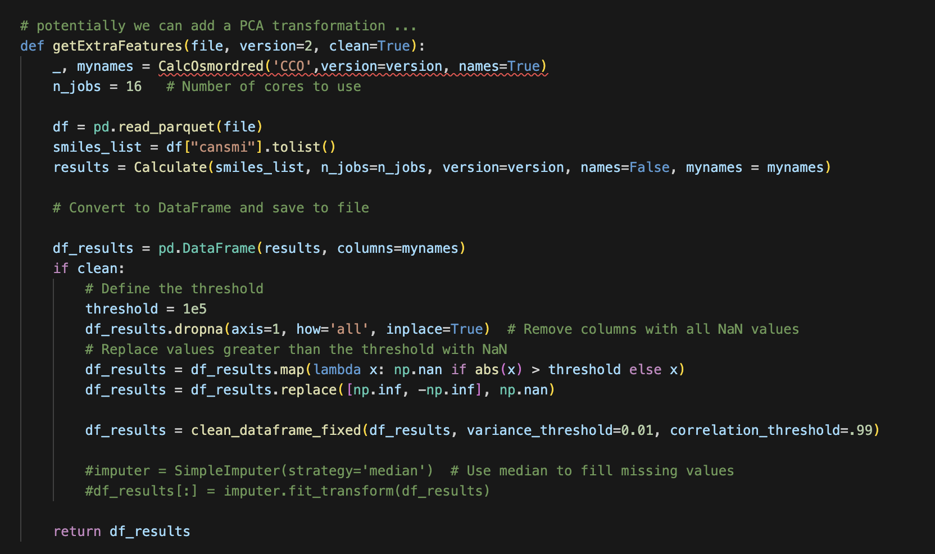
Normalize and Prune Osmordred features
Remove static features, low variance features, highly correlated features

Slide 18


Speed example
30 threads on a server
Graph featuring single thread
Much simpler task…

Slide 19
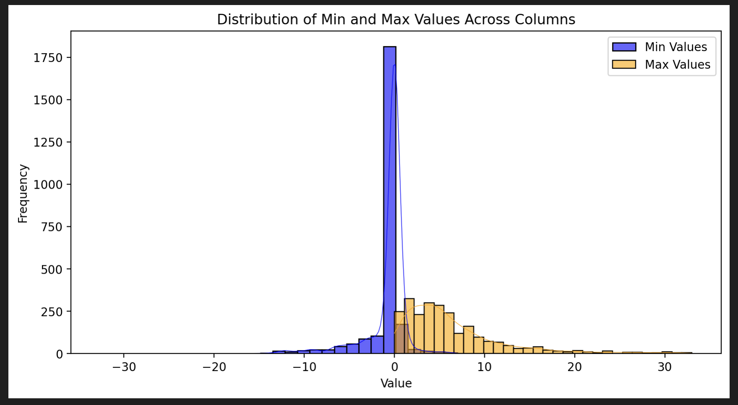

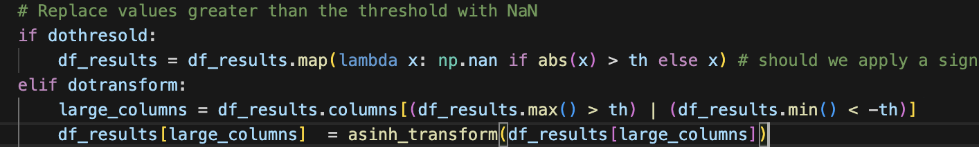
Better normalize data
Th = 33

Slide 20
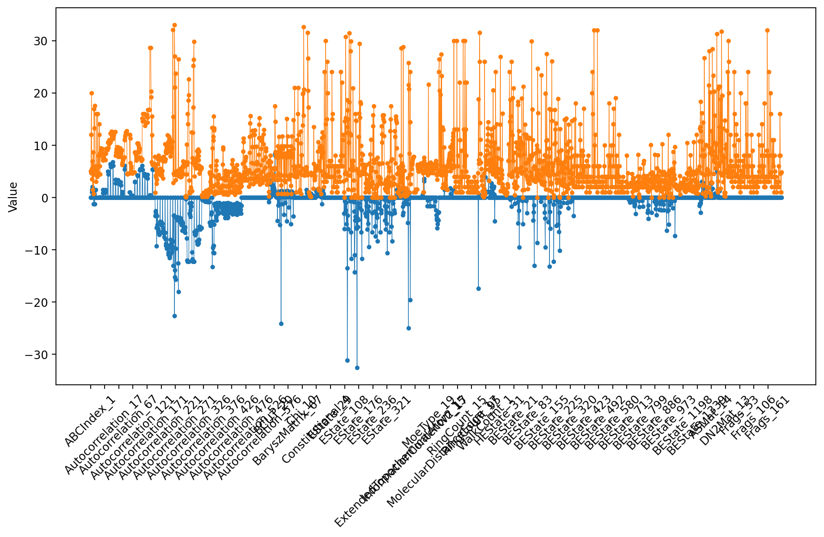
Better normalize data

Slide 21
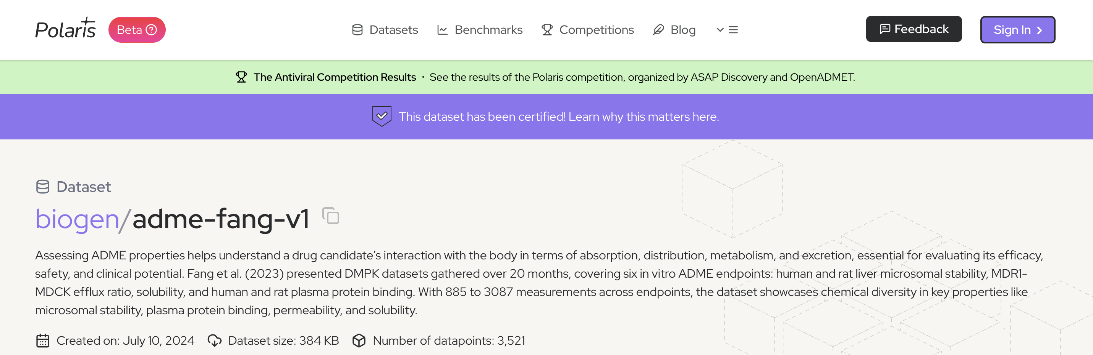
PatWalters evaluation
https://github.com/osmoai/osmordred

Slide 22
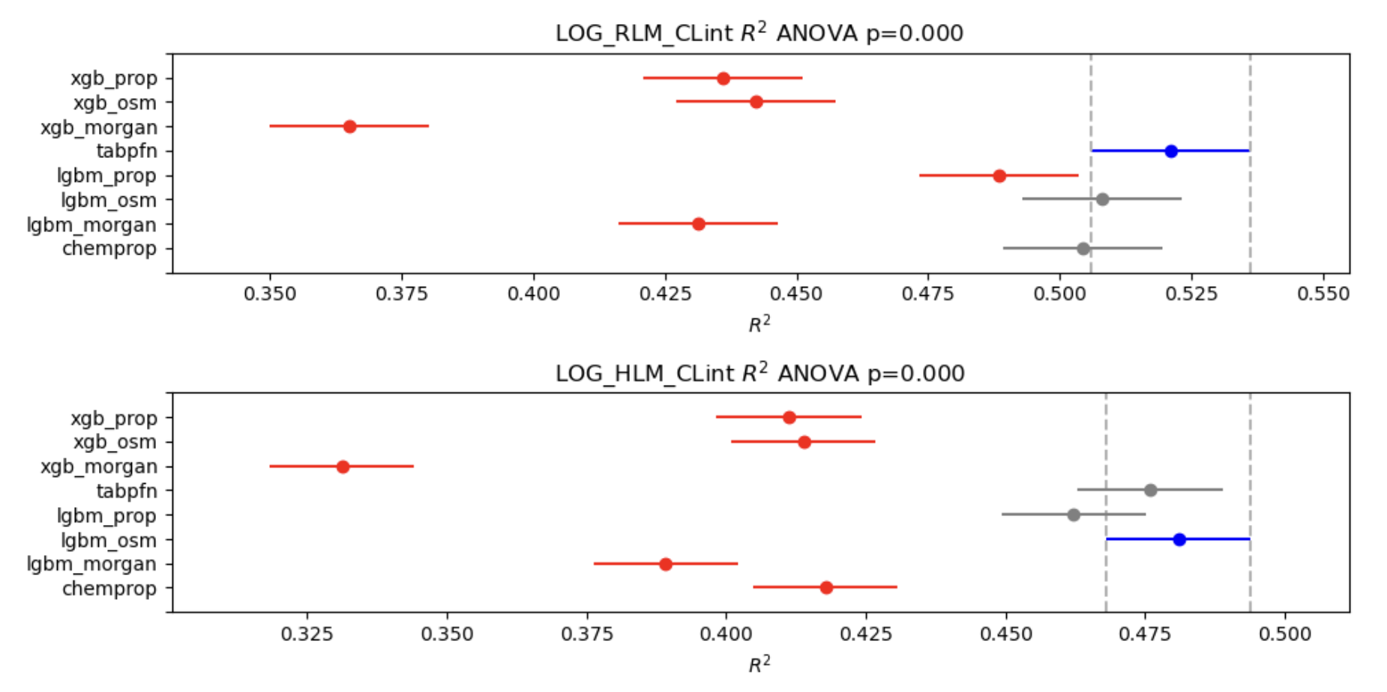
PatWalters evaluation
https://github.com/osmoai/osmordred
https://github.com/PatWalters/practical_cheminformatics_posts/blob/main/adme_comparison/ADME_Comparison.ipynb

Slide 23
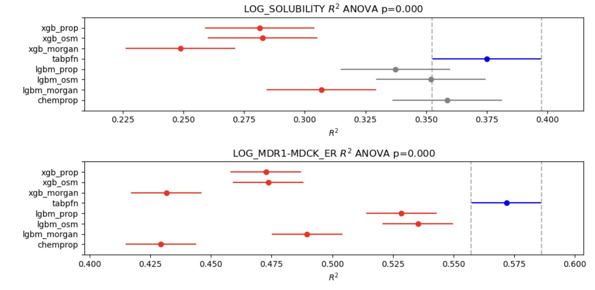
PatWalters evaluation
https://github.com/osmoai/osmordred
https://github.com/PatWalters/practical_cheminformatics_posts/blob/main/adme_comparison/ADME_Comparison.ipynb

Slide 24
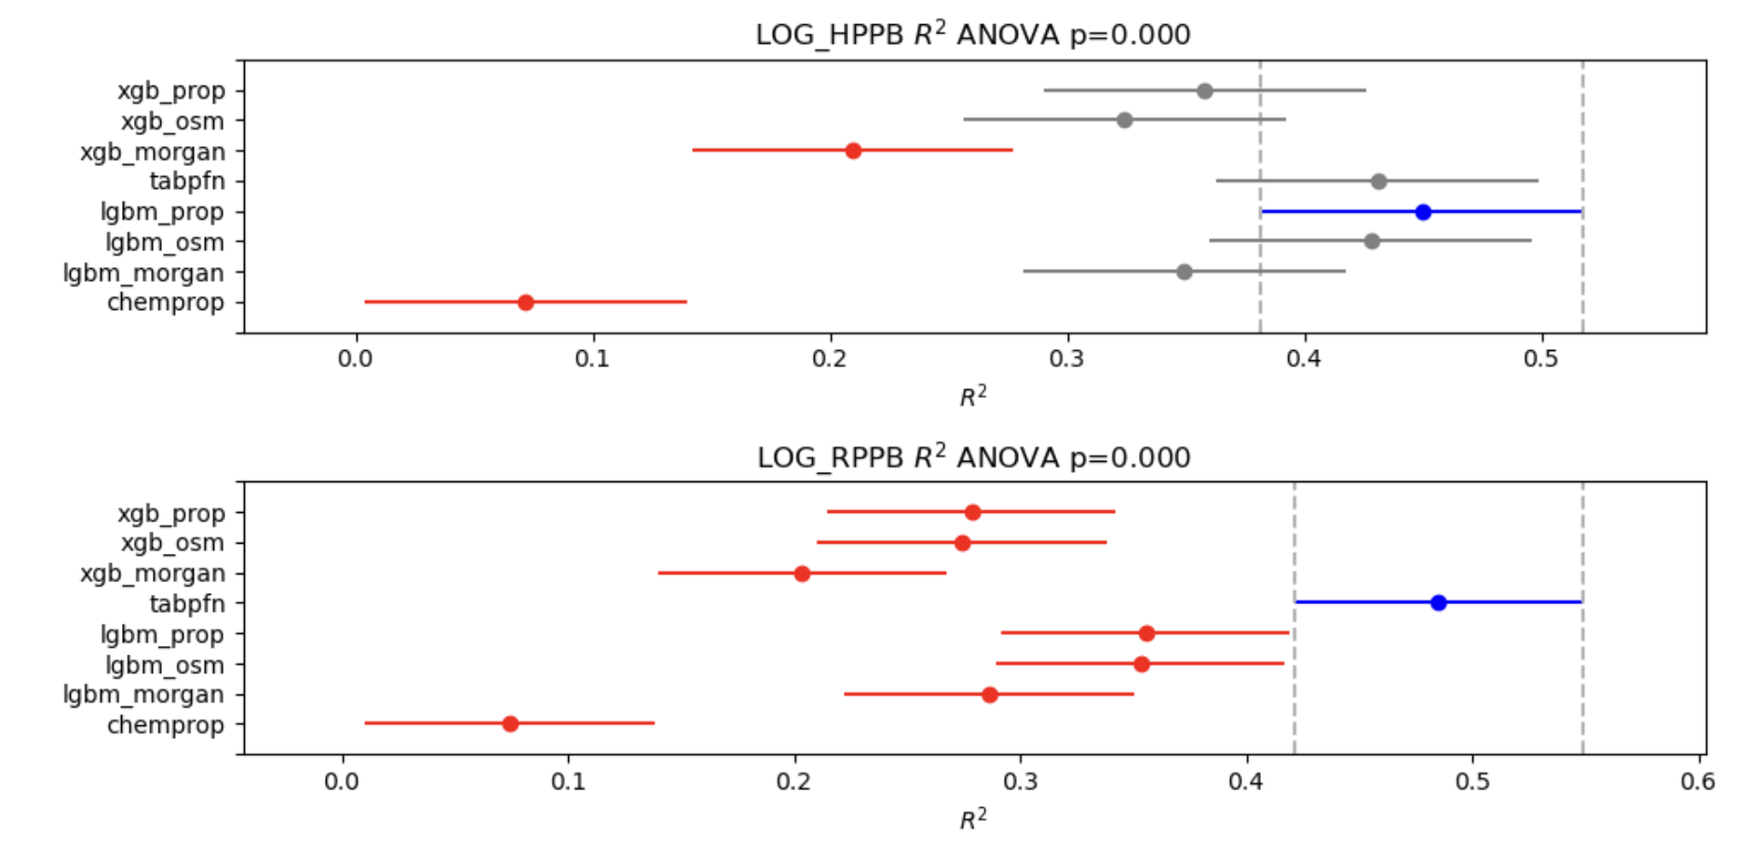
PatWalters evaluation
https://github.com/osmoai/osmordred
https://github.com/PatWalters/practical_cheminformatics_posts/blob/main/adme_comparison/ADME_Comparison.ipynb

Slide 25
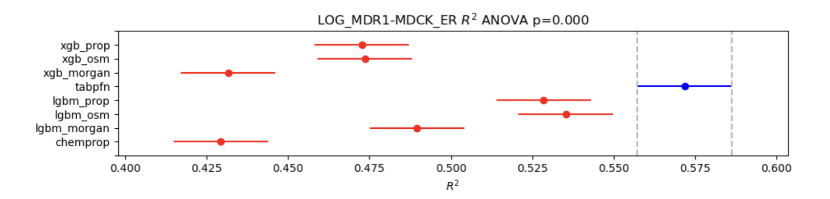

Current status:
Only 2D descriptors for speed (from Chemopy, Padel, Mordred)
Move to cpp version python codes already in RDKit
Adding more descriptors Estate derivatives & Basak
Cpp / python rdkit native interface
Conclusion
Potential improvements :
Easier installation
Python to cpp threading
SMARTS substructure threading
Reuse mol input instead of Smiles
If there are no feature enough correlated (>0.5) to target, don’t use it !
Normalize the features using arcsin transformation function only on large values.

Slide 26
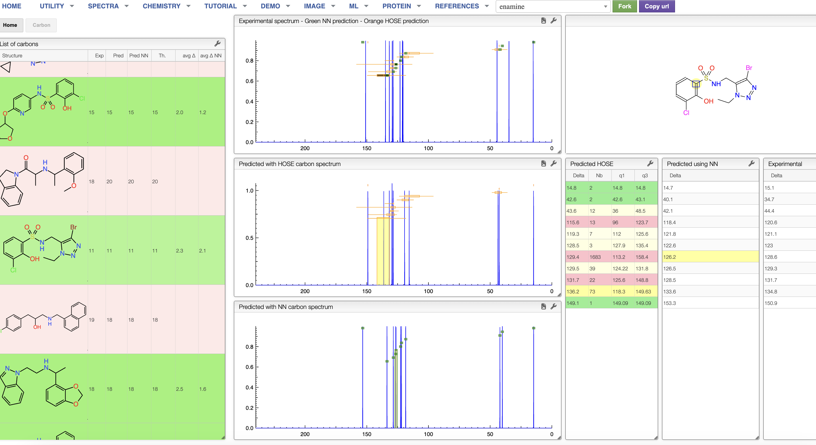
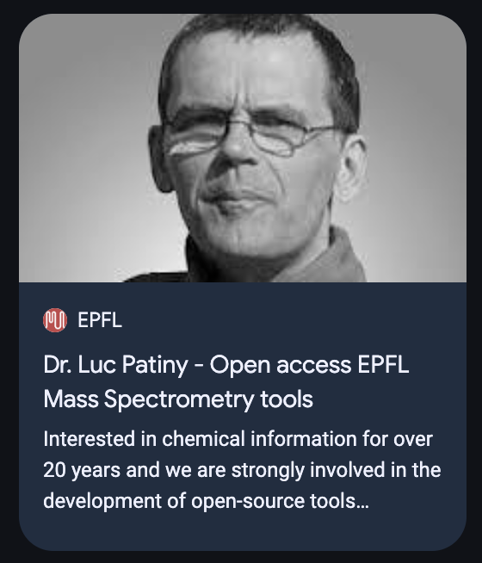
Prediction C13 NMR
Call for new data
https://www.linkedin.com/in/lpatiny

Slide 27
Thanks to Osmo team!

Slide 28
End

Slide 29
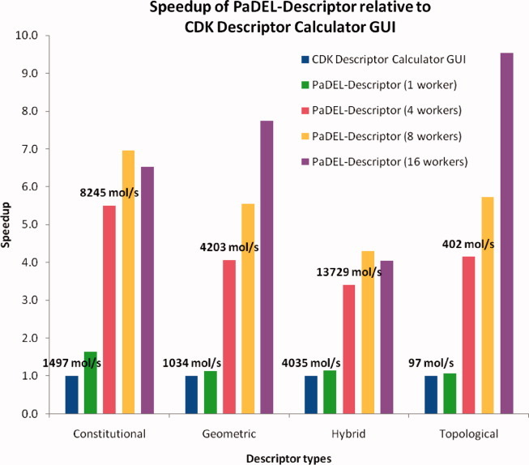
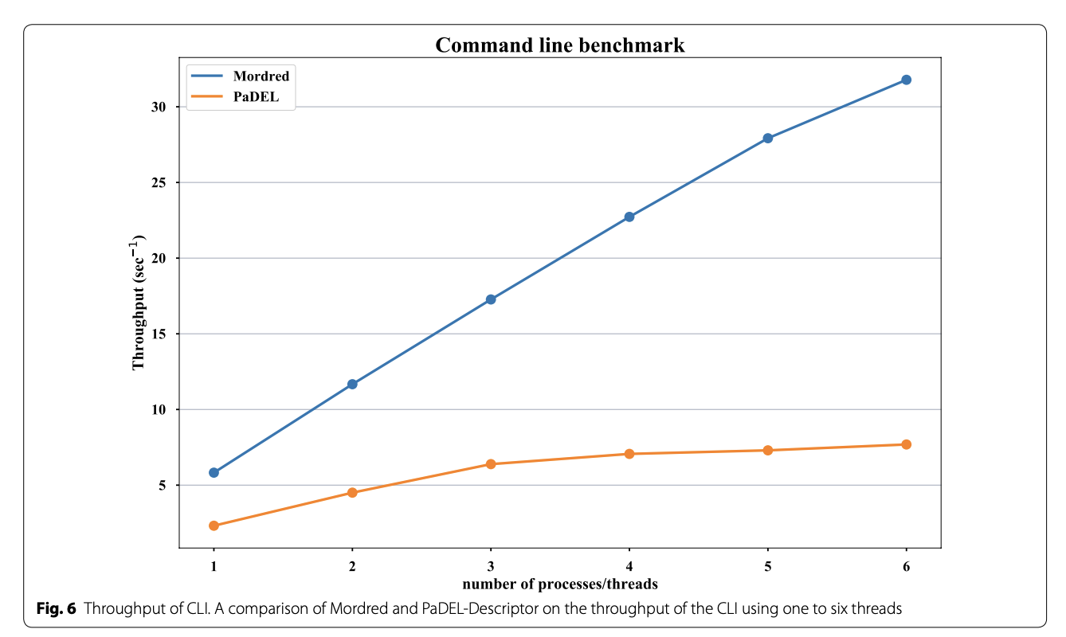
Parallelization : Padel (2010) vs Mordred (2018)
~1600 Descriptors
Java based on CDK
Python based on RDKit optimizing duplicated operations on
mol object like distance matrix etc…

